Slide 1





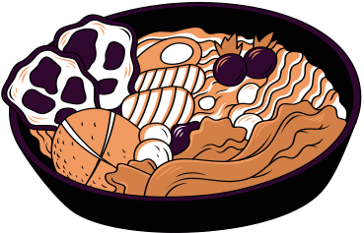
Ain Shams University
Computer Science | 2023
1

Slide 2

Agenda
Objectives
Experiments & Results
System Architecture
Short Demo
Explanation of finished phases
What's next?
Description of Dataset
2

Slide 3
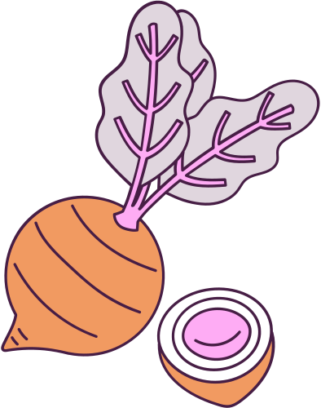
Objectives
The main objective of the project is to estimate meal calories, this can be achieved by
Identifying meal ingredients.
Estimating of each ingredient quantity.
Calculating total meal calories based on each ingredient quantity.
Build an interactive user-friendly platform that encourages users to manage their nutrition plan.
3

Slide 4
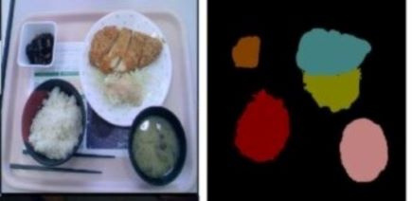

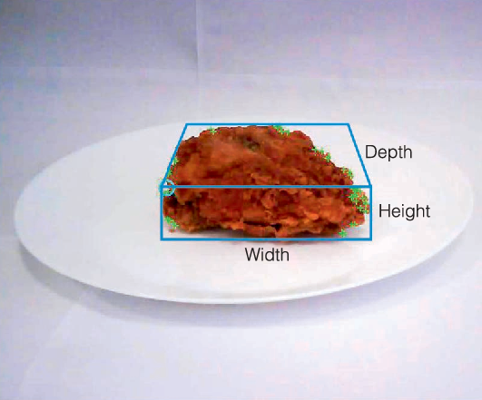
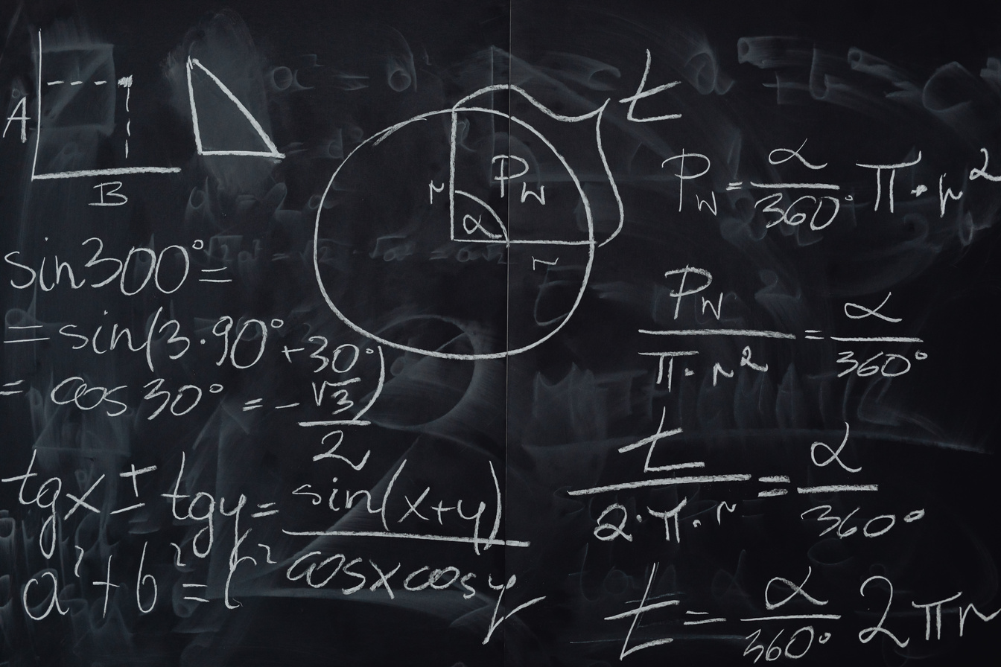
Challenges
Ingredient
Identification
Volume
Estimation
Calories
Calculation
Identifying each unique
Ingredient in the meal.
Extracting depth information from 2D image.
Calculate the calories based on the portion.
4

Slide 5
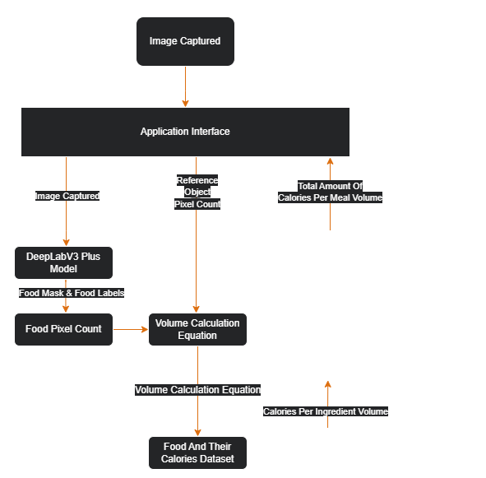



System Architecture
5

Slide 6
Food Classification
Explanation of finished phases
We built a deepLabV3 Plus model to identify the ingredient
Training Pixel Accuracy 82%
Testing Pixel Accuracy 74%
6

Slide 7
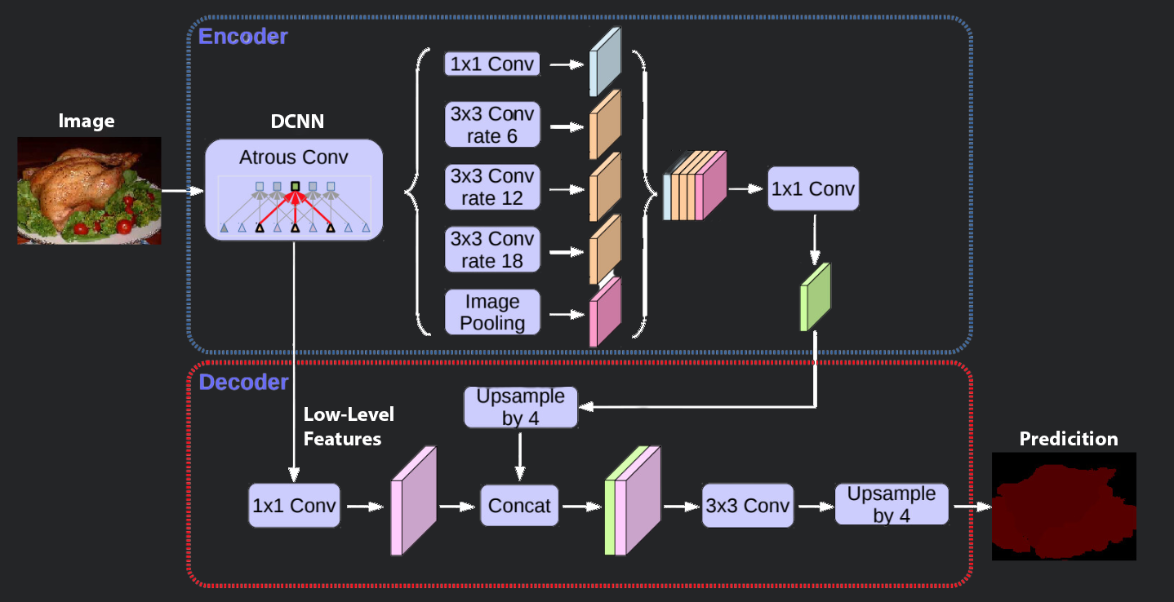
DeepLabV3 Plus Model Architecture
7

Slide 8
Volume Estimation
Explanation of finished phases
Approach:
the usage of a reference object by comparing reference object pixels with the ingredient pixels
8

Slide 9
Explanation of finished phases
Calories Estimation
List your goals here
List your goals here
List your goals here
9

Slide 10

Description of Datasets
UECFOODPIXCOMPLETE
UECFoodPix and UECFoodPixComplete are food images dataset with segmentation masks including 9,000 images for training and 1,000 image for testing.
The Segmentation masks are augmented by food category.
In UECFoodPix, the mask images is created using a bounding box and GrabCut, and In UECFoodPixComplete there is provided manualy. The mask images have pixel-wise food 103 class labels, and only R(red) channel have this labels.
10

Slide 11

Description of Datasets
Food And Their Calories
The dataset contains a csv file with more than 300 foods each with the amount of Calories, Fats, Proteins, Saturated Fats, Carbohydrates, Fibers labelled for each food.
Also, the foods are also categorised into various groups like Desserts, Vegetables, Fruits etc.
11

Slide 12




EXPERIMENTS & RESULTS
DATASET TRIALS
MODEL
TRIALS
TRIED TECHNIQUES
Tried out datasets and their compatibility with our goal
Implemented models,
their strengths and weaknesses
Different techniques used
12

Slide 13
Dataset Trials
FoodSeg103
Incomputable dataset with our goal.
the labels doesn't map to food categories.
UECFOODPIXCOMPLETE
Dataset used to develop deepLapV3 Plus model successfully.
Food and their calories
Dataset used to retrieve the calorie count of each food ingredient.
13

Slide 14
Model Trials
SeaFood Model
semantic segmentation model adopts the DeepLab-V3 neural network architecture with MobileNet-V2 backbone, It was trained and evaluated on a Google-internal food ingredient parsing dataset.
it has very small variety of food categories (26 category), and the categories are vague Ex: It sees apple and orange as same category (Fruits)
14

Slide 15
Model Trials
ID-Card-Segmentation Model
The model was using U-net architecture but the model was sensitive to the surrounding objects and couldnot detect the right id card and the mask was not satisfying for the desired result.
the data was not diverse enough to capture all the variations and nuances of ID cards.
15

Slide 16
Technique Trials
Hough Lines Transform
could not get the right lines to can get the id card trying different combinations of thresholding and Noise reduction and enhancement methods including Gaussian Blur, Median Blur and Morphological Operations
15

Slide 17
Technique Trials
SIFT
there are not enough keypoints detected in the ID card segmentation so that algorithm could not be able to find a sufficient number of matches to establish a reliable correspondence.
15

Slide 18
Technique Trials
Contour analysis (successful)
smooths the image with a Gaussian blur, detects edges with a Canny algorithm, finds contours with four sides and a certain area and convexity, checks the angle between the sides to identify rectangles, and returns a list of detected rectangles.
15

Slide 19





What's Next?
Model accuracy improvements by fine-tunning or adding helper classification model
what future has in store for ClorieMe?
Development of a fine-tuned ID model to reduce human error
Further improvement to remove the reference object constraint
16
1

